Slide 1
Project Idea
Presentation 1
CSE 4510 – Software Development

Slide 2
Team Composition
Member Name | Member ID
Shakleen Ishfar | 160041029
Abir Ahbab | 160041032

Slide 3
Project 1: Level Up!
Mobile productivity application

Slide 4
Main Idea
Measure benefits of a productive life-style through reward and penalty system.
Measure productivity across 4 regions.
  Strength: Track health activity.
  Wisdom: Flash card study system.
  Resistance: Refrain from bad habits.
  Perseverance: Manage daily, weekly, monthly goals.
Use stats earned through productive workload to play and advance in the built-in game.

Slide 5




Technologies
Dart/Flutter
Single code base
Native android and iOS support
Unity 5 Game Engine
Optimized for mobile platform.
Widely used.
Blender
Open source.
Power 3D modeling software.

Slide 6



Competitors
Habitica! | Forest | Todoist

Slide 7
Project 2: Solve it
Mobile equation solver.

Slide 8
Main Idea
Solve equations by using your smartphone camera.
Handwritten mode.
The more it is used, the better it gets at making out hand-writing.

Slide 9

Technologies
Dart/Flutter
Single code base
Native android and iOS support
Java
Versatile
Numerous machine learning libraries.

Slide 10
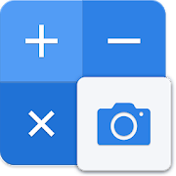
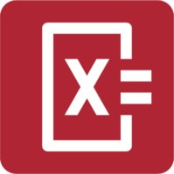

Competitors
Calculator Pro PhotoMath Office Lens

